Slide 1
What is AI, ML, DL, and DS?
Artificial Intelligence (AI): When machines do things that need human intelligence.
Machine Learning (ML): A part of AI where machines learn patterns from data.
Deep Learning (DL): A part of ML that learns using special "brain-like" structures called neural networks.
Data Science (DS): Using data to answer questions or make decisions
Machine Learning has 3 main types:
Supervised Learning – Learn from examples with answers.
Unsupervised Learning – Group things by similarity, no answers given.
Reinforcement Learning – Learn by trying, getting rewards or penalties.

Slide 2
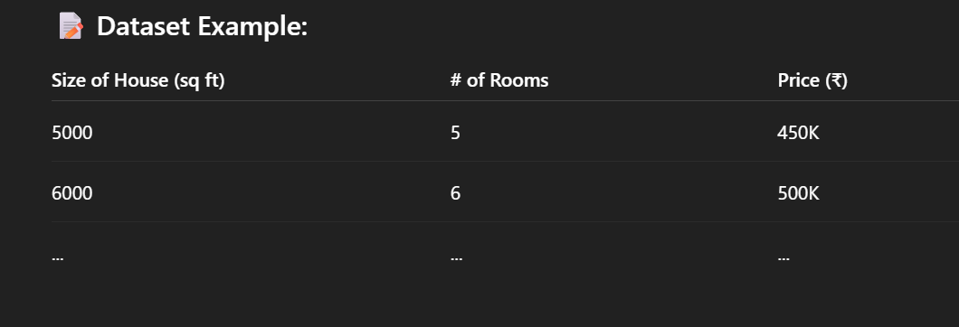
Supervised Learning
The computer is given data + correct answers.
It learns the pattern and can predict answers for new data.
Supervised Machine Learning – Regression:

Slide 3
KEY TERMS WE WILL USE DURING OUR SESSIONS:
Term | Meaning
Independent Features | Inputs used for prediction (e.g., size of house, No of rooms)
Dependent Feature | Output being predicted (here: Price)
Output Feature (O/P) | Another name for dependent/target variable
Continuous | Output can take any numeric value (used in regression)
Regression Task | When the dependent feature is continuous, we use regression
Used in Supervised Learning: We feed the model both the inputs and correct outputs during training.

Slide 4
Supervised Machine Learning – Classification
Study Hours | Play Hours | Result (Label)
7 | 3 | Pass
2 | 6 | Fail
6 | 2 | Pass
3 | 5 | Fail
5 | 4 | Pass
1 | 8 | Fail
4 | 4 | ??? (Predict)
How Classification Works:
The model learns patterns: e.g., more study & less play → Pass
It may draw a boundary line in a graph where one side = "Pass", other = "Fail"
For new input like (4 study, 4 play), model checks which side it falls on and predicts.

Slide 5
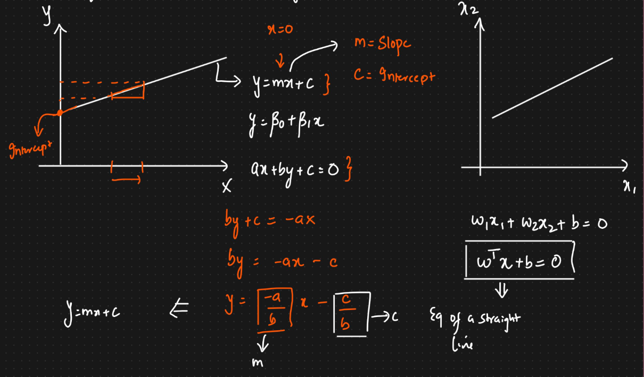
MATHS BEFORE LEARING ML:
EQUATION OF LINE

Slide 6
Evaluation metrices:
MAE (Mean Absolute Error)
Tells average size of errors (in original units). Smaller MAE = better predictions.
MSE (Mean Squared Error)
Errors are squared before averaging. Larger errors hurt more; lower is better.
RMSE (Root Mean Squared Error)
Square root of MSE, in same unit as target. Lower RMSE = more accurate model.
R² Score (R-Squared)
Tells how much variation the model explains. Closer to 1 = better; 0 = poor model.
Adjusted R²
R² adjusted for number of input features. Use when there are many features; higher is better.

Slide 7
How to interpret these values?
🔹 MAE (Mean Absolute Error) Tells average prediction error in original units. Lower MAE = More accurate model. MAE = 0 → Perfect predictions.
🔹 MSE (Mean Squared Error) Larger errors have more impact (squared). Lower MSE = Fewer large mistakes. Big gap between MSE & MAE → Model has outliers.
🔹 RMSE (Root Mean Squared Error) Like MAE but punishes big errors more. Same units as target → Easy to compare. Lower RMSE = Model is more reliable.
🔹 R² Score R² = 1 → Perfect model (explains all variation). R² ≈ 0 → Model is no better than guessing. R² < 0 → Model is worse than baseline.
🔹 Adjusted R² Adds penalty for too many features. If Adjusted R² < R² → Some features may be useless. Prefer higher Adjusted R² for complex models.

Slide 8
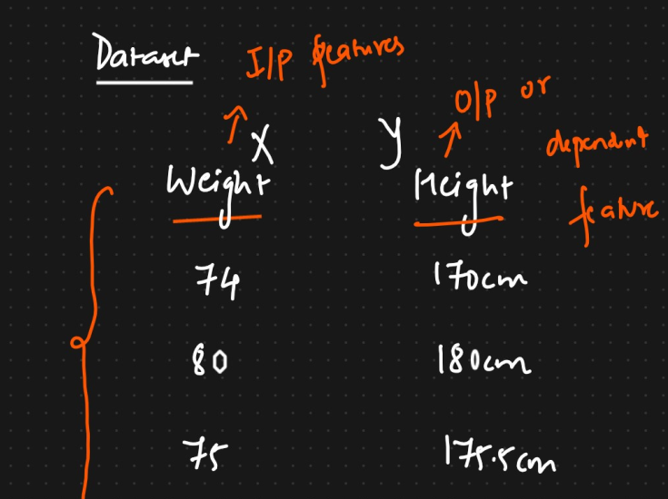
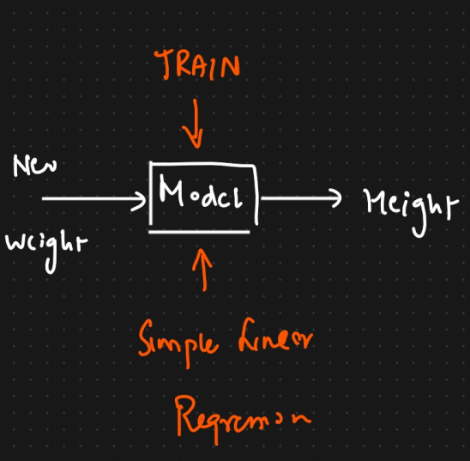
An Introduction to Simple Linear Regression
Simple Linear Regression is a supervised machine learning algorithm used to model the relationship between two continuous variables. It aims to find the best-fitting straight line through the data points that can be used to predict the value of a dependent variable based on the value of an independent variable.

Slide 9
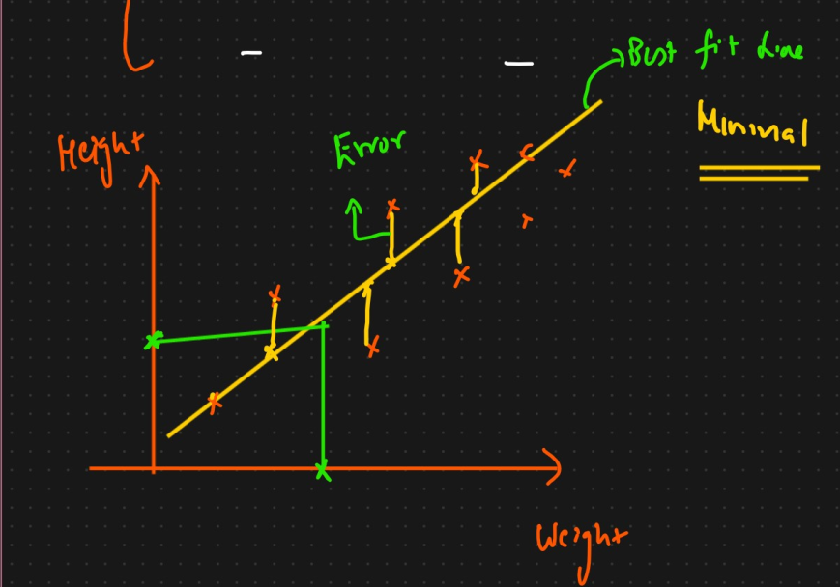
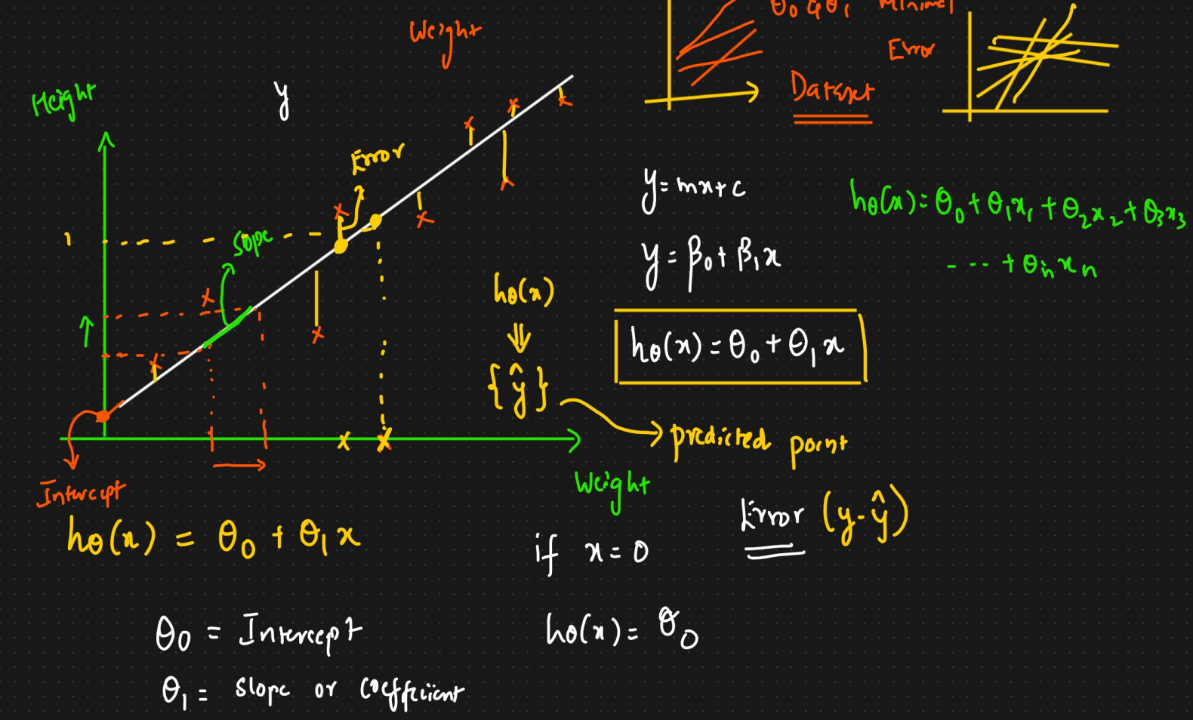
BEST FIT LINE AND ERROR IN LR:

Slide 10
Hypothesis Function – The Model Equation
Simple Linear Regression uses this function:
hθ(x) = θ₀ + θ₁x
Where:
hθ(x) = Predicted output (e.g., predicted weight)
θ₀ = Intercept (prediction when x = 0)
θ₁ = Slope (effect of a one-unit increase in x)
x = Independent variable (e.g., Height)
Goal: Find the best values for θ₀ and θ₁ to fit the data.

Slide 11
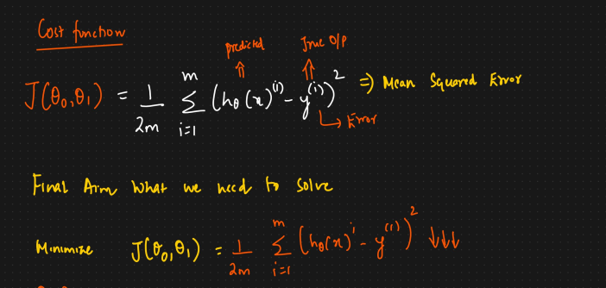
Cost Function – Measuring Model Error
We need to measure how bad the predictions are.
We use the Mean Squared Error (MSE) as the cost function:
J(θ₀, θ₁) = (1/2m) ∑(hθ(xᶦ) - yᶦ)²
Where:
m = Number of training examples
hθ(xᶦ) = Predicted value
yᶦ = Actual value
Lower cost = better model.
Goal: Minimize J(θ₀, θ₁)

Slide 12
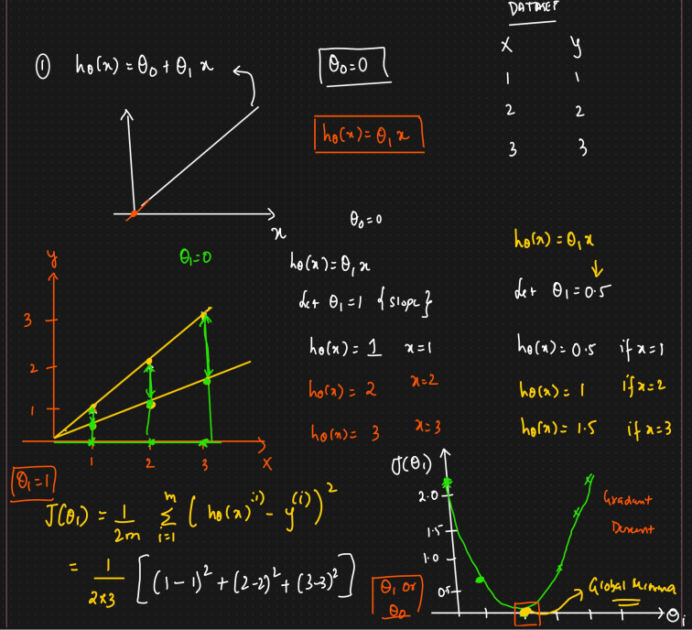
HOW TO MINIMIZE THIS COST FUNCTION?
Gradient Descent is used to minimize the cost function.
It updates θ₀ and θ₁ step by step by moving in the direction of the steepest descent.
General update rule:
θⱼ := θⱼ - α × ∂J/∂θⱼ
Where:
θⱼ = Parameter being updated
α = Learning rate (step size)
∂J/∂θⱼ = Derivative of cost function w.r.t θⱼ

Slide 13
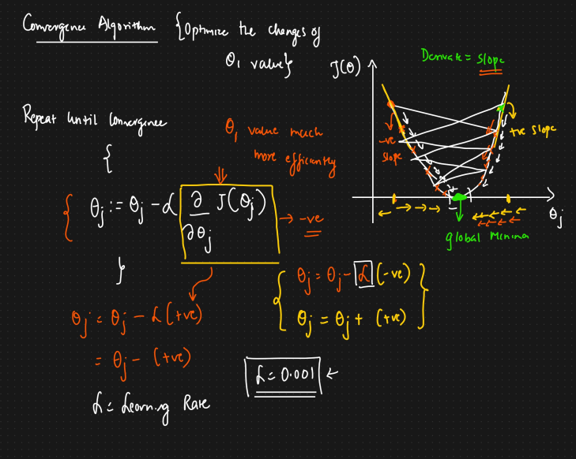
CONVERGENCE ALGO INTUITION:

Slide 14
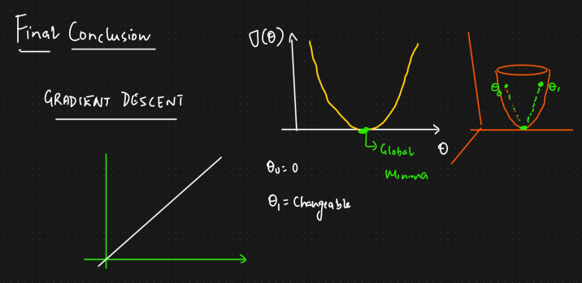
OUR FINAL GOAL:
Repeat until convergence {
θ₀ := θ₀ - α × (1/m) ∑(hθ(xᶦ) - yᶦ)
θ₁ := θ₁ - α × (1/m) ∑(hθ(xᶦ) - yᶦ)·xᶦ

Slide 15
Summary
Linear regression fits a line using known (x, y) pairs.
We model it with hθ(x) = θ₀ + θ₁x
We minimize the cost using Gradient Descent
Final output is a line that predicts y for any new x
NOW WE WILL DO A SIMPLE PROJECT AND PRACTICAL FOR PREDICTION USING LINEAR REGRESSION

